Slide 1

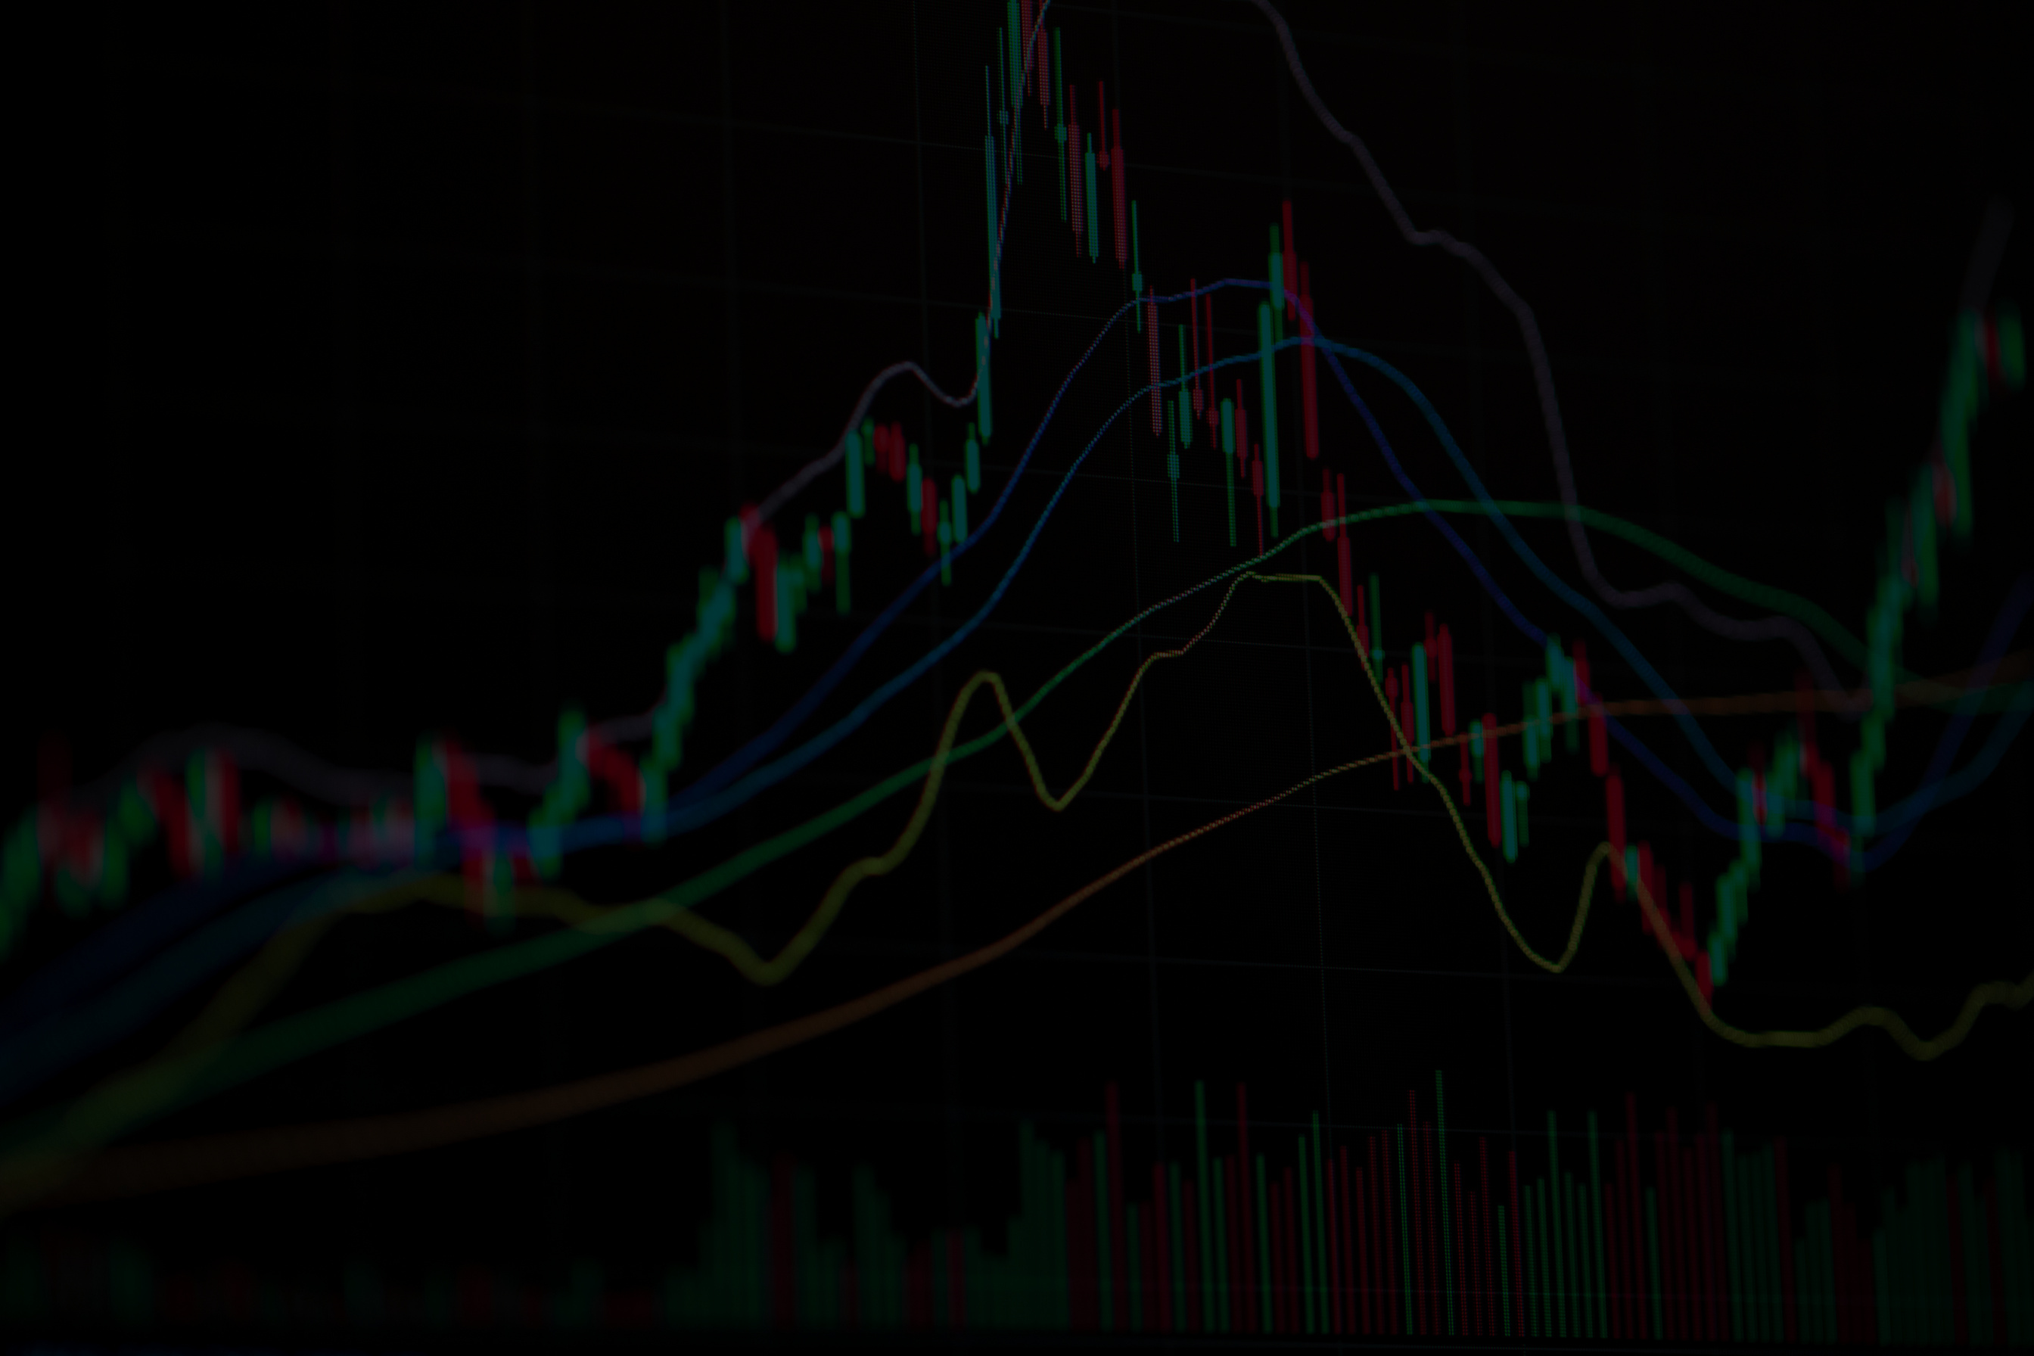

TRADING PERFORMANCE DASHBOARD
BY NILOY SAHA
www.reallygreatsite.com
USING POWER BI

Slide 2
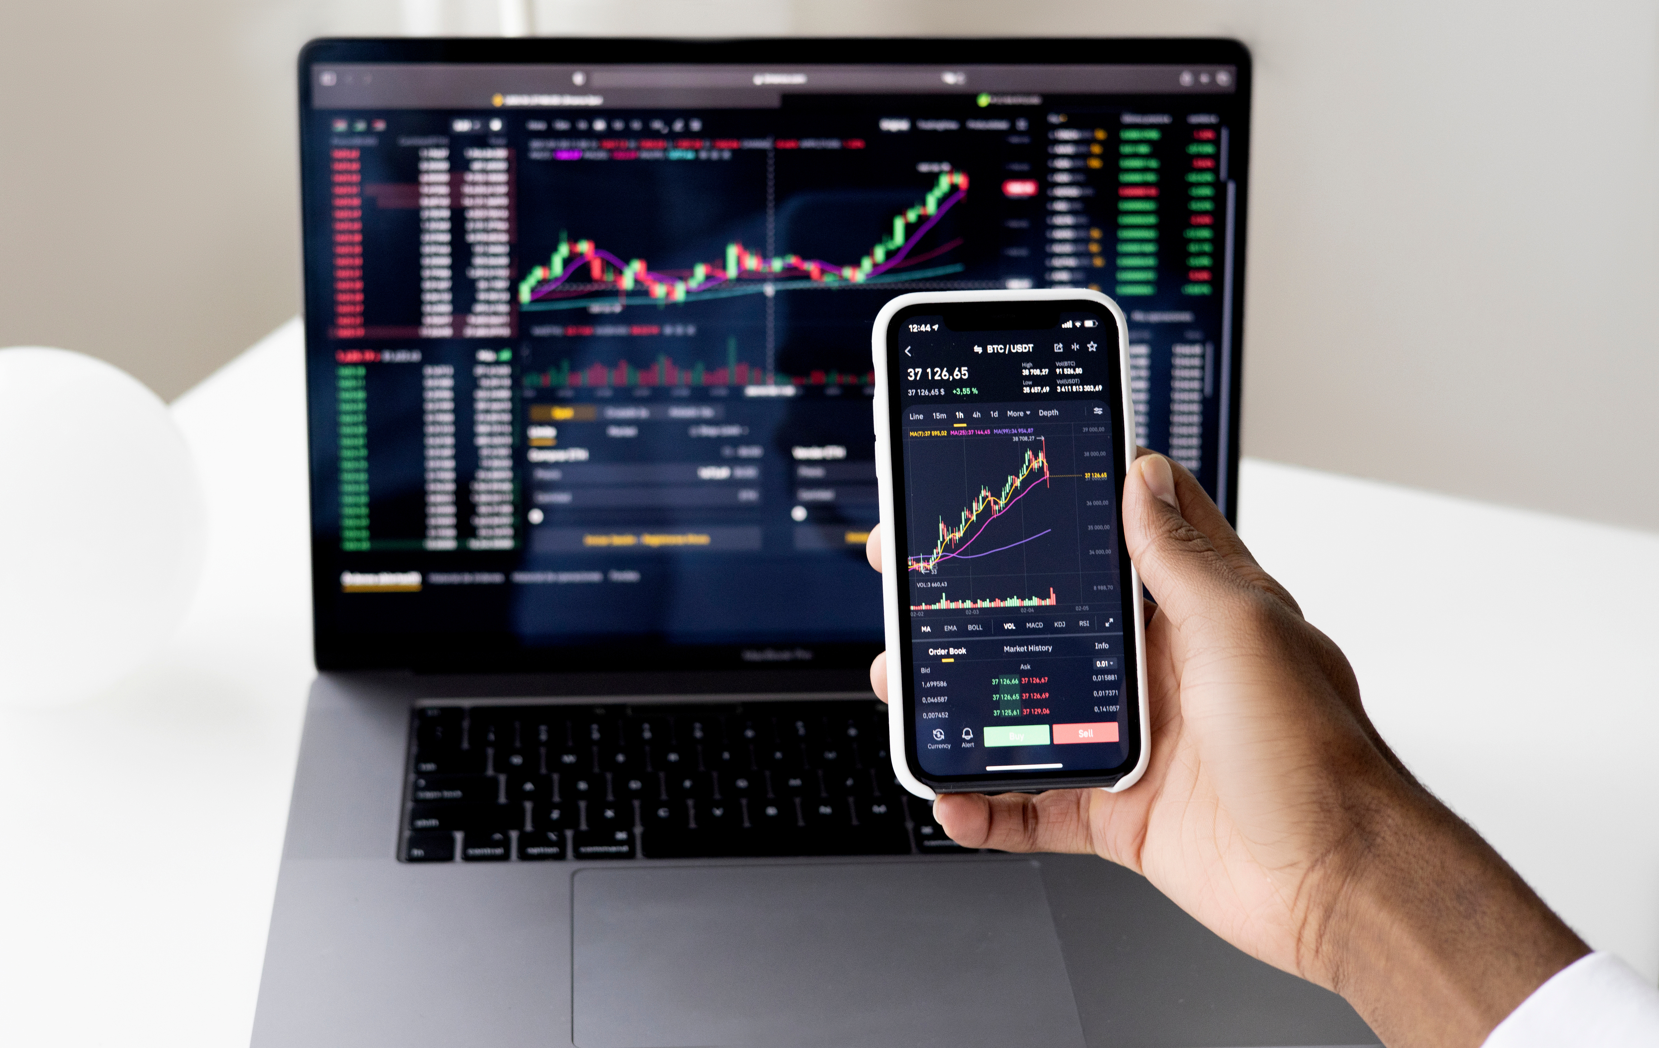

About this
dashboard
This dashboard is designed to provide a clear, actionable, and data-driven view of trading performance.
It transforms raw trade data into meaningful insights that help identify what works, what doesn’t, and where profitability truly comes from.
The focus is not just on profit and loss, but on consistency, risk management, trade quality, and behavioral patterns over time.
By visualizing performance across days, weeks, trade types, and instruments, this dashboard enables better decision-making and strategy optimizatio

Slide 3
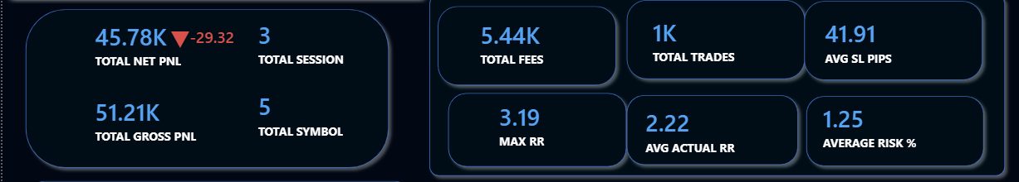
Over view of
Trades
Insights
Total Net PnL (45.78K) reflects the final profitability after all costs, showing strong overall performance.
Total Gross PnL (51.21K) highlights the raw earning potential before fees, confirming a profitable edge in the strategy.
Total Fees (5.44K) indicate transaction and execution costs, helping evaluate cost efficiency.
Total Trades (1K) across 3 trading sessions and 5 symbols show diversified and active participation in the market.
Average Stop-Loss (41.91 pips) demonstrates controlled downside exposure per trade.
Maximum Risk-Reward (3.19) shows the best risk efficiency achieved.
Average Actual Risk-Reward (2.22) confirms consistent positive expectancy.
Average Risk % (1.25%) reflects disciplined risk management and capital protection.
The metrics indicate a well-balanced trading approach with strong profitability, controlled risk, and consistent execution across multiple instruments.

Slide 4
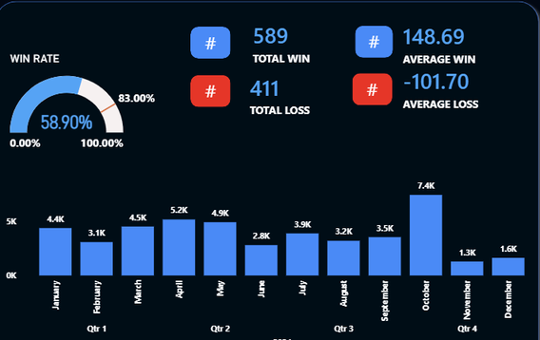
Insights
Win Rate (58.9%) – More than half of trades are profitable, showing a consistent edge.
Trade Distribution – Winning trades (589) exceed losing trades (411), confirming strategy reliability.
Risk–Reward Advantage – Average win (+148.69) is larger than average loss (−101.70).
Monthly Performance – Profits remain positive across most months with no major drawdowns.
Best Month – October delivered the highest profitability, indicating peak performance.
Stability – Month-to-month fluctuations are controlled, reflecting disciplined risk management.

Slide 5
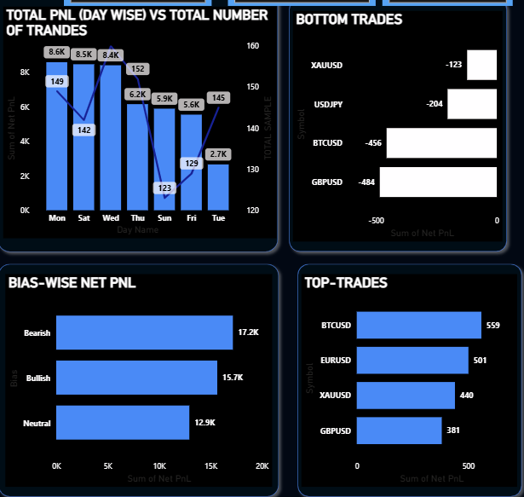
Detailed analysis
Insights
Mid-week performance is strongest, with Wednesday and Saturday generating the highest Net PnL.
Trade frequency does not guarantee profitability — days with more trades sometimes produced lower Net PnL.
Tuesday shows the weakest performance, contributing the lowest Net PnL among weekdays.
GBPUSD and BTCUSD are the biggest loss contributors, dominating the bottom trades list.
Bearish market bias outperforms bullish and neutral, delivering the highest Net PnL overall.
BTCUSD is the top-performing instrument, followed by EURUSD and XAUUSD.
Losses are concentrated in fewer symbols, indicating risk is not evenly distributed across instruments.

Slide 6
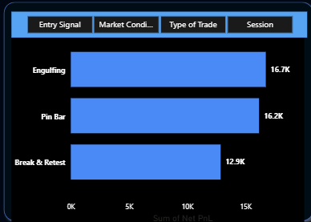
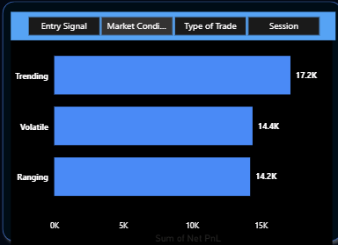
Detailed analysis
Insights according entry signals
Engulfing is the most profitable entry signal, generating the highest Net PnL.
Pin Bar performs consistently well, closely following Engulfing in overall profitability.
Break & Retest delivers moderate returns, but lags behind price-action based signals.
Simple price-action signals outperform complex setups, indicating better clarity and execution.
Focusing on Engulfing and Pin Bar setups can improve overall expectancy.
Insights according market conditions
Trending markets deliver the highest profitability, showing clear directional edge.
Volatile conditions perform strongly, but slightly below trending markets.
Ranging markets generate the lowest returns, indicating reduced edge in sideways price action.
Strategy performs best when aligned with market direction, not consolidation.
Filtering trades to trending conditions can significantly improve Net PnL.

Slide 7
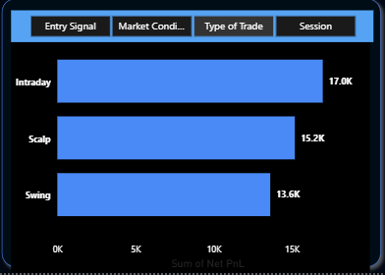
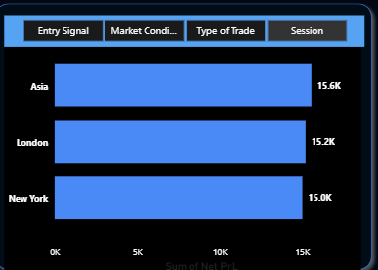
Detailed analysis
Insights according type of trade
Intraday trading generates the highest Net PnL, showing strongest consistency.
Scalping performs well, but slightly underperforms intraday trades.
Swing trading delivers the lowest Net PnL, indicating slower capital efficiency.
Short-term trading styles outperform longer holding periods.
Focus on intraday setups can maximize overall profitability.
Insights according sessions
Trending markets deliver the highest profitability, showing clear directional edge.
Volatile conditions perform strongly, but slightly below trending markets.
Ranging markets generate the lowest returns, indicating reduced edge in sideways price action.
Strategy performs best when aligned with market direction, not consolidation.
Filtering trades to trending conditions can significantly improve Net PnL.

Slide 8
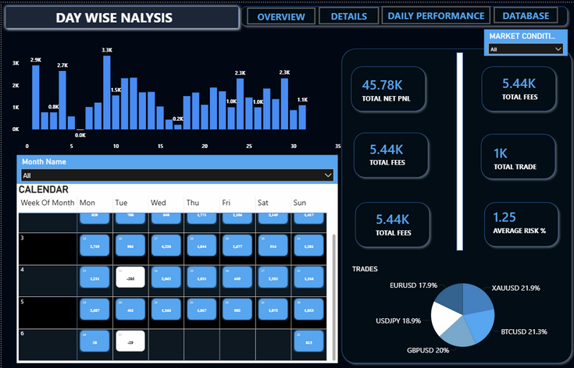
Detailed analysis
Day wise performance insights
The calendar highlights daily Net PnL distribution across the selected month.
Consistent profitability is visible on multiple mid-month trading days.
Losses are isolated to specific dates, indicating controlled drawdowns rather than prolonged losing streaks.
Performance shows no continuous loss clusters, reflecting disciplined risk management.
Strong days are spread across different weeks, suggesting strategy robustness rather than luck.
The visual calendar enables quick identification of high- and low-performance days for better trade planning.

Slide 9
Recommendation
1. Optimize Trading Days Based on Performance
Increase focus on days with consistently higher Net PnL.
Reduce or avoid aggressive trading on historically weak days.
Use day-wise performance to plan weekly trade allocation.
2. Strengthen Risk Management on Low-Performing Days
Apply tighter stop-loss rules on loss-prone days.
Reduce position size when market conditions align with past drawdowns.
Protect overall equity by limiting exposure on volatile days.
3. Leverage Calendar Insights for Trade Planning
Use the calendar view to identify profitable trading patterns.
Align trade execution with historically strong weekdays.
Avoid overtrading on days showing repeated negative performance.

Slide 10
Recommendation
4. Maintain Consistent Strategy Execution
Continue using setups that show steady profitability across days.
Avoid unnecessary strategy changes during short-term drawdowns.
Focus on execution quality rather than trade quantity
5. Continuous Performance Review & Optimization
Review day-wise performance monthly to detect pattern shifts.
Refine strategies based on evolving market behavior.
Use insights to make data-driven improvements, not emotional decisions.

Slide 11
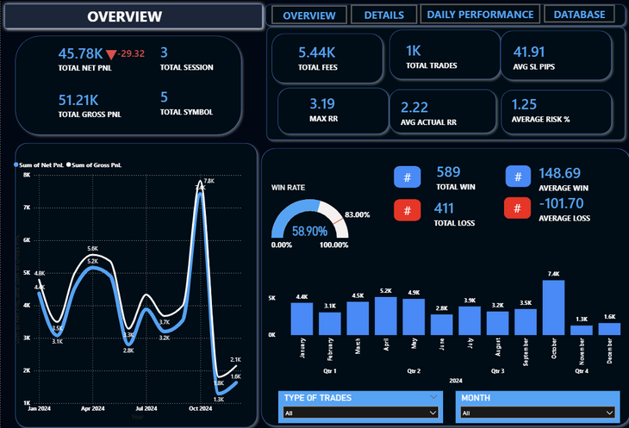
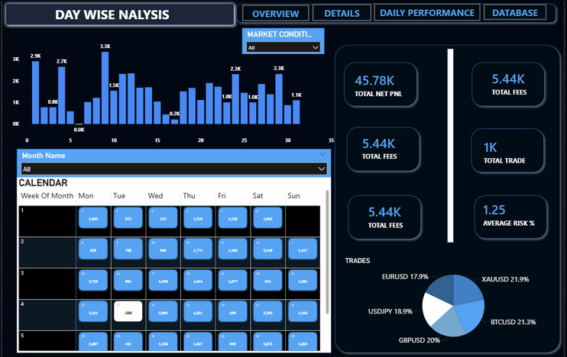
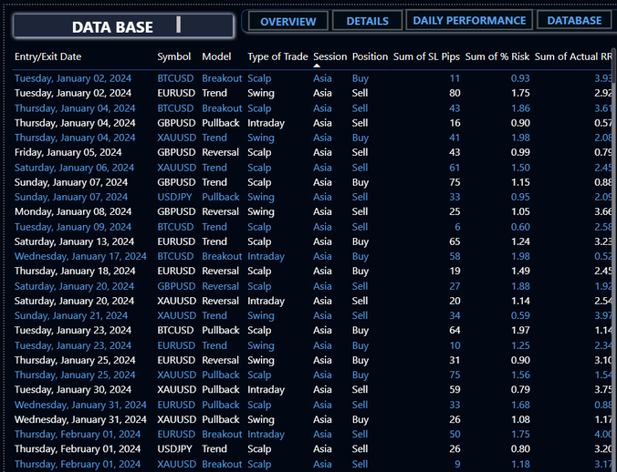
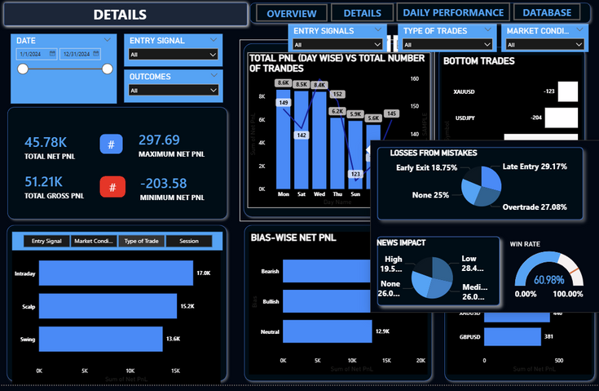
Dashboards

Slide 12
THANK
YOU.
www.reallygreatsite.com

